Slide 1
Name : Md.Jewel Hossain
S0-05(19)
Smart office management

Slide 2
What is diphtheria?
Diphtheria is a highly contagious and potentially life-threatening bacterial disease caused by Corynebacterium diphtheriae. There are two types of diphtheria: respiratory and cutaneous. Respiratory diphtheria involves the nose, throat and tonsils, and cutaneous diphtheria involves the skin.

Slide 3
Is diphtheria a pathogen or virulence?
Diphtheria is a pathogen, but diphtheria toxin and pili have been identified as major virulence factors, little is known about factors involved in bacterial colonization and development of disease.

Slide 4
Respiratory diphtheria :
The bacteria most commonly infect the respiratory system, which includes parts of the body involved in breathing. When the bacteria get into and attach to the lining of the respiratory system, it can cause:
(i) Weakness
(ii) Sore throat
(iii) Mild fever
(iv) Swollen glands in the neck
The bacteria make a toxin that kills healthy tissues in the respiratory system. Within two to three days, the dead tissue forms a thick, gray coating that can build up in the throat or nose. Medical experts call this thick, gray coating a “pseudomembrane.”

Slide 5
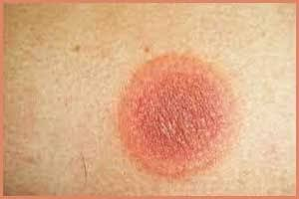
Cutaneous diphtheria :
This type of diptheria bacteria may present as a scaling rash or ulcers with clearly demarcated edges and membrane, but any chronic skin lesion may harbor C. diphtheriae along with other organisms. The systemic complications from cutaneous diphtheria with toxigenic strains appear to be less than from other sites.

Slide 6
Signs and symptoms :
Diphtheria can infect the respiratory tract (parts of the body involved in breathing) and skin. Symptoms of diphtheria depend on the body part that is affected. People who are exposed to diphtheria usually start having symptoms in 2–5 days if they get sick. If a doctor thinks you have respiratory diphtheria, they will have you start treatment right away.

Slide 7
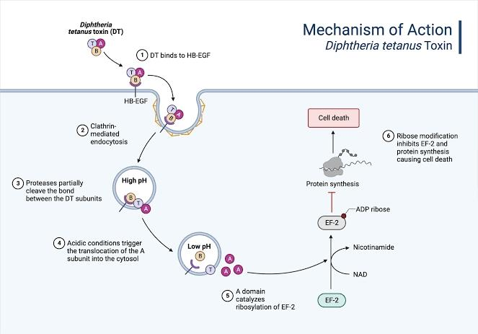

Slide 8
Diptheria toxin mechanism
Diphtheria toxin kills cells by inhibiting eukaryotic protein synthesis, and its mechanism of action has been extensively characterized. This potent toxin inactivates elongation factor (EF-2) required for protein synthesis (Collier, 1967).

Slide 9
Vaccine:
Vaccines are available that help prevent diphtheria, an infection caused by Corynebacterium diphtheriae bacteria. Three kinds of vaccines used in the United States today help protect against diphtheria, all of which also provide protection against other diseases:Diphtheria, tetanus, and pertussis (DTaP) vaccinesTetanus, diphtheria, and pertussis (Tdap) vaccinesTetanus and diphtheria (Td) vaccinesBabies and children younger than 7 years old receive DTaP, while older children and adults receive Tdap and Td.

Slide 10
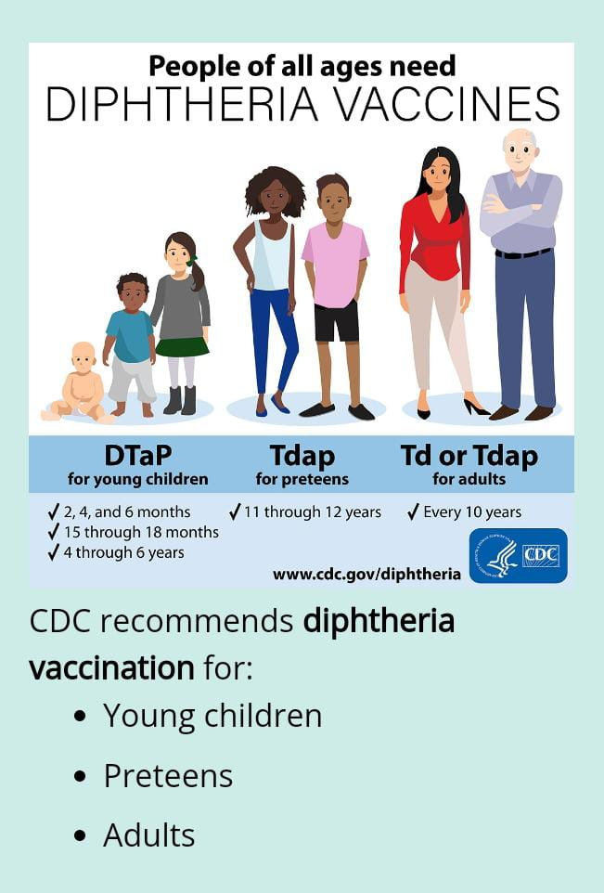

Slide 11
Common causes of this symptom
Diarrhoea can have causes that aren't due to underlying disease. Examples include a liquid diet, food intolerance, stress, anxiety or use of laxatives.

Slide 12
Thank you Everyone

